Slide 1

TRANSFORMERS INTUITION Residual Layer Norm and Position-Wise Feedforward Network
By Srinivas Rahul
NANO COMPUTION RESEARCH GROUP

Slide 2

Layer Normalization
Normalizes features of one sample in one batch.
Include:
- Layer Normalization
- Residual Connection
We need to normalize data before we feed into model such that it has zero mean.
Other Normalization Techniques – batch norm. group norm
Mean of data
Standard Deviation of data

Slide 3

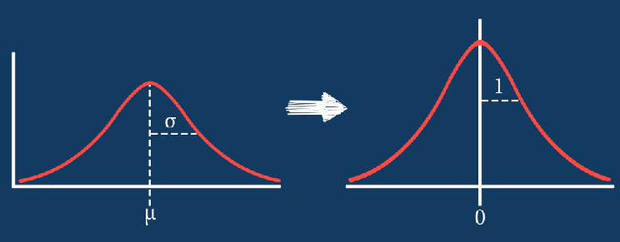
Layer Transformation applies Learned Transformation
Β, λ - Learnable Parameters
Learnable parameters are learned by neural network

Slide 4
Residual Connections
Normalize outputs of Multi-Head Attention.
Theory of Neural Network – If we stack layers, we should get lower training error.
Training error
Practical
Lead to overfitting
Theory
Number of layers

Slide 5


Plane Network vs Residual Network
Plane Network
Residual Network
Learns difference from previous layers.
So, every other layer have some information about layer before that. (not preceding layer)

Slide 6
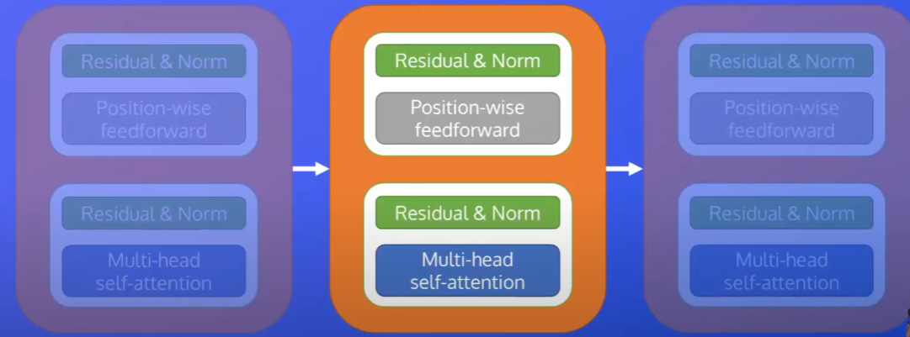

Slide 7
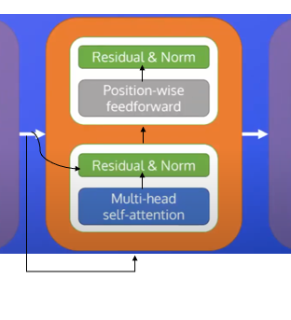
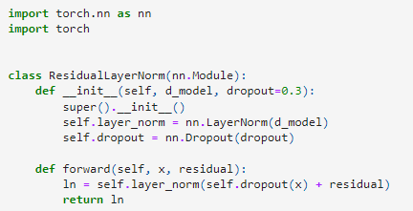
Code

Slide 8
Position-Wise Feed Forward Network
Lower computational complexity of the model.
Used to project attention layer output richer representations.
For dealing with long sequences.
Same weights are applied to every element in sequence.
[word_1 word_2 word_3]
Same transformation is applied to every element in the tensor

Slide 9

Formula
ReLu activation on output w.r.t W1
Two layered network
We project x into larger dimensionality and apply activation to it and projected back to D.

Slide 10

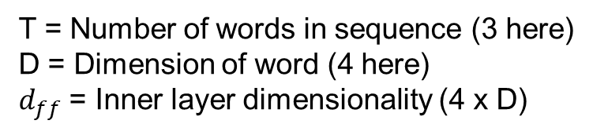


Dimensions of Feed Forward Neural Network
T = Number of words in sequence (3 here)
D = Dimension of word (4 here)
$d_{ff}$ = Inner layer dimensionality (4 x D)
[D x $d_{ff}$]
Input Dimension to FFNN
[T x D]
[T x $d_{ff}$]
[$d_{ff}$ x D]
Output Dimension to FFNN
[T x D]

Slide 11
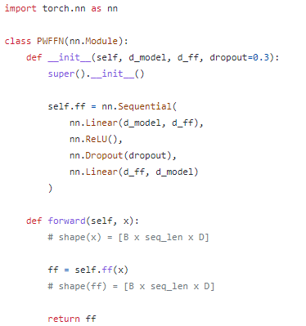
Code
[1 x 4 x 3]

